Slide 1
HOTEL BOOKING MANAGEMENT SYSTEM
GROUP-2
MENTOR:
RAHUL VIKASH
Notes:
©2016 Capgemini. All rights reserved. The information contained in this document is proprietary and confidential. For Capgemini only.

Slide 2
Objectives
Project Understanding
Approach used
Project Execution
Modules
Learning
Best Practices
Opportunity for improvement
Demo and Code Walkthrough

Slide 3
Project Understanding
This project is aimed at developing a Hotel booking management system for hotels those are using a manual system to handle hotel processes. There are three main users in hotel management system, administrator, employee and customer.
Notes:
Add instructor notes here.

Slide 4
Project Understanding (Contd.)
1. ADMIN
The functionalities are:
Add hotel/room
Modify hotel/room
Update hotel/room
View reports
Notes:
Add instructor notes here.

Slide 5
Project Understanding (Contd.)
2. Customer
The functionalities of Customers are:
Register into the system.
Login to the system using his/her credentials.
Search for hotel rooms.
Book hotel rooms.
View Booking Status
Notes:
Add instructor notes here.

Slide 6
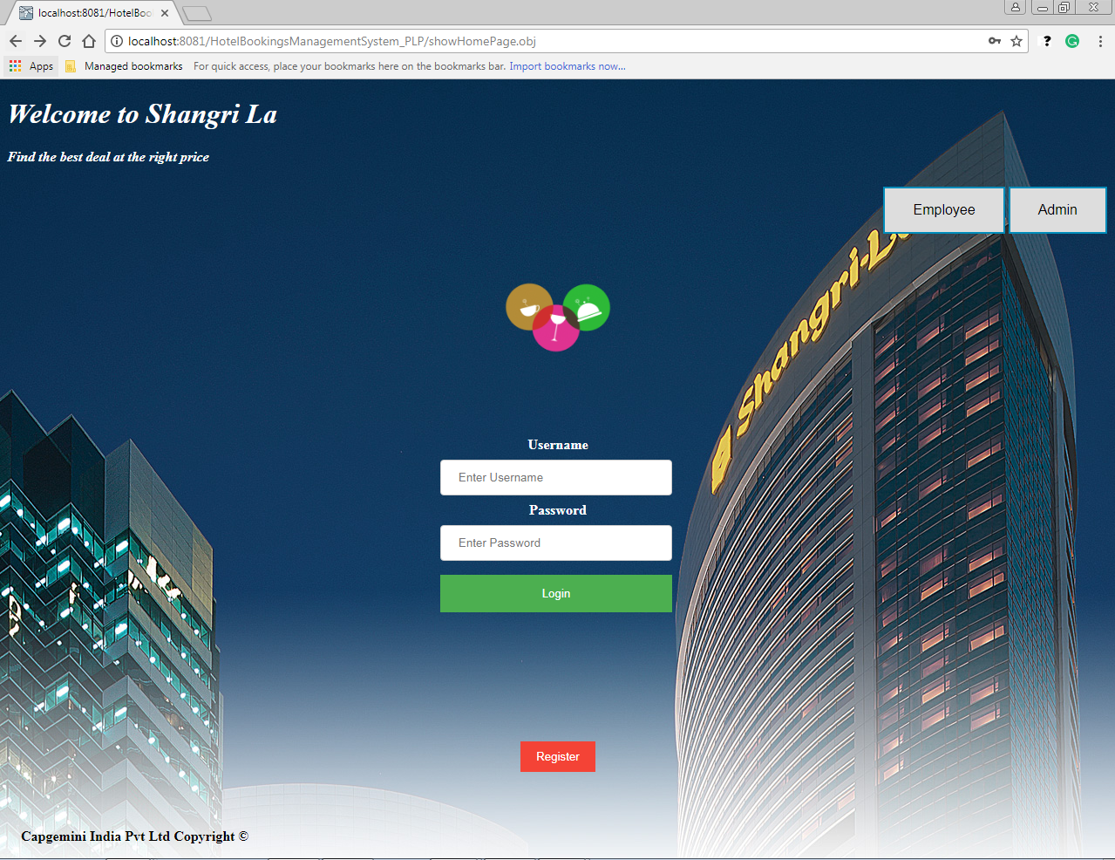
Customer Login

Slide 7
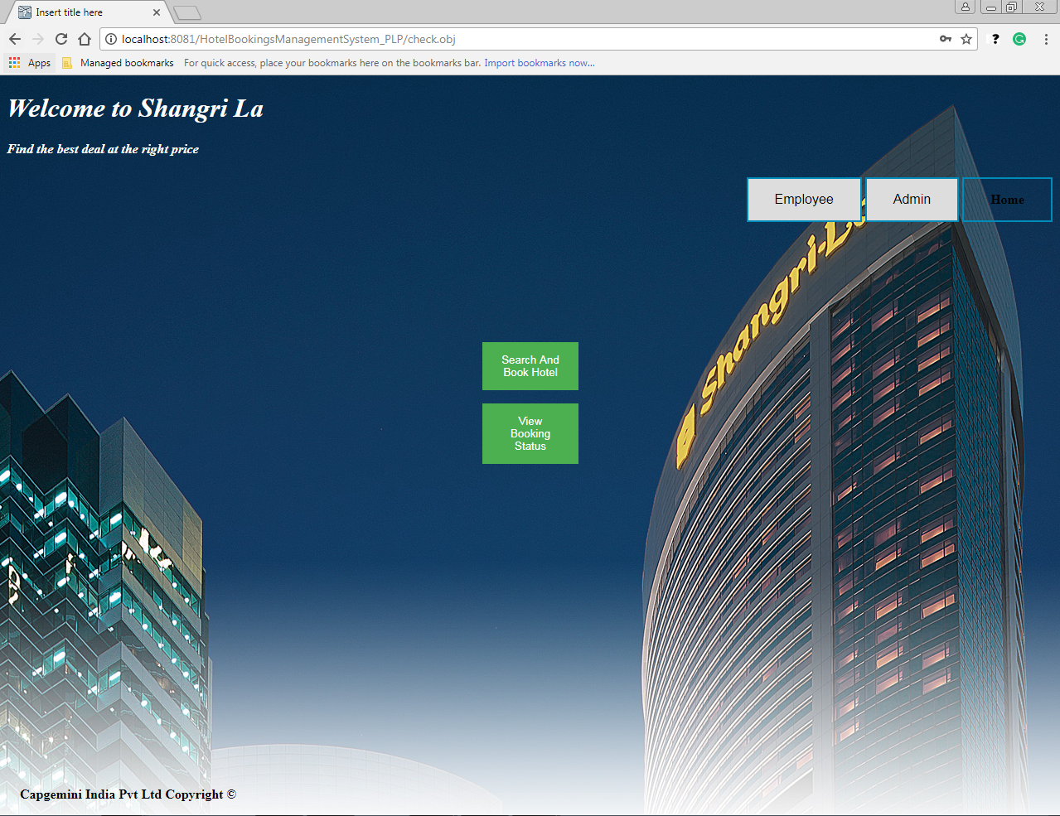

Slide 8
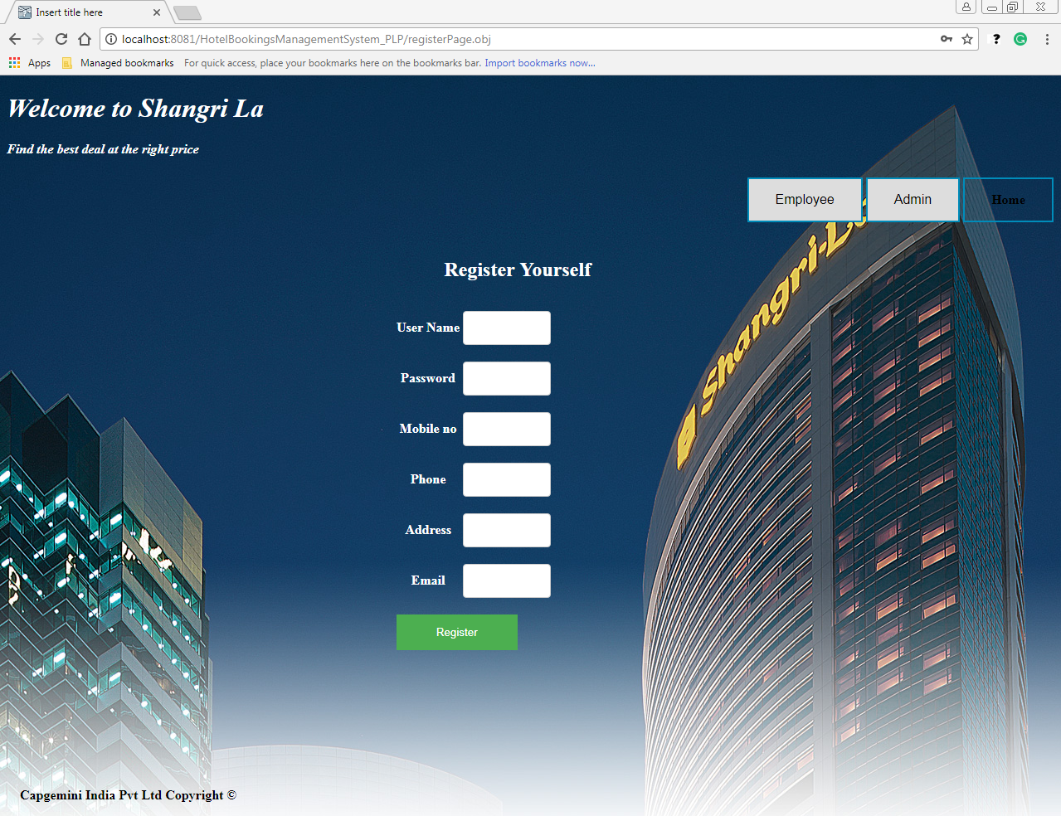

Slide 9
Project Understanding (Contd.)
3. Employee
The functionalities of Employees are:
Register into the system.
Login to the system using his/her credentials.
Search for hotel rooms.
Book hotel rooms.
View Booking Status
Notes:
Add instructor notes here.

Slide 10
Approach Used
In this application we have followed Modular Programming. Modular Programming is a process which divides a computer program into separate sub-programs.
A module is a separate software component, which can be used in a variety of applications and functions with other components of the system. Similar functions were grouped in the same unit of code and separate functions are developed as separate units of code so that the code can be reused.
Modular programming enabled us to divide the work and debug pieces of the program independently. Modules were designed in such a way to minimize dependencies between different modules.
Notes:
Add instructor notes here.

Slide 11
Modules
Add Hotel/Room
Modify Hotel/Room
Update Hotel/Room
View Reports
Login
Register Employee/Customer
Show for Hotel rooms
Book Hotel Room
View Booking Status
Notes:
Add instructor notes here.

Slide 12
Modules
Login: This module takes the Username ,Password and the Role(i.e. Admin or Participant). If its valid the user is forwarded to respective home page.
Register Employee/Customer: This module enables a participant to enter user details for both Employee and Customer.
Add Hotel/Room : In this module when user(admin) selects a hotel/room, the respective hotel/room is added.
Notes:
Add instructor notes here.

Slide 13
Modules
View Reports: In this module the admin can view day to day activities of Hotel( Admin can view daily reports).
Delete Hotel/Room : In this module when user(admin) selects a particular hotel/room, the respective hotel/room is deleted from database.
Modify Hotel/Room: In this module when user(admin) selects a particular hotel/room, the respective hotel/room is updated from database.
Notes:
Add instructor notes here.

Slide 14
Modules
Show for Hotel Rooms:
In this module the Customer/Employee can display the hotel rooms.
The existing records in the table can are displayed.
Book Hotel Room:
In this module new Hotel Room can be added by Customer/Employee, if the booking is available.
View Booking Status:
In this module existing booking status is displayed.
Notes:
Add instructor notes here.

Slide 15
Scope And Out of Scope of Project
In our current system an Admin/Customer/Employee can login
using username, password and role. But, in case an Admin/ Customer/Employee enter incorrect details then it will asked to enter correct credentials.
Registration by admin:
The Login and Logout button using session will be added to our system later.
Notes:
Add instructor notes here.

Slide 16
THANKYOU

